Slide 1
FOREVERBOARD
By: Alexander Kevin Pipes

Slide 2
Goals
A mix between Microsoft Paint and Google Docs
Free hand drawing
Live updating
Supports Multiple users at once
Drawings are saved by URL
All URLs are valid including no URL
Endless amounts of fun

Slide 3
How To
foreverboard.eastus.cloudapp.azure.com
Left click to draw
Release to send
Add any extension you want!
Ex: foreverboard.eastus.cloudapp.azure.com/PleaseBeNice

Slide 4
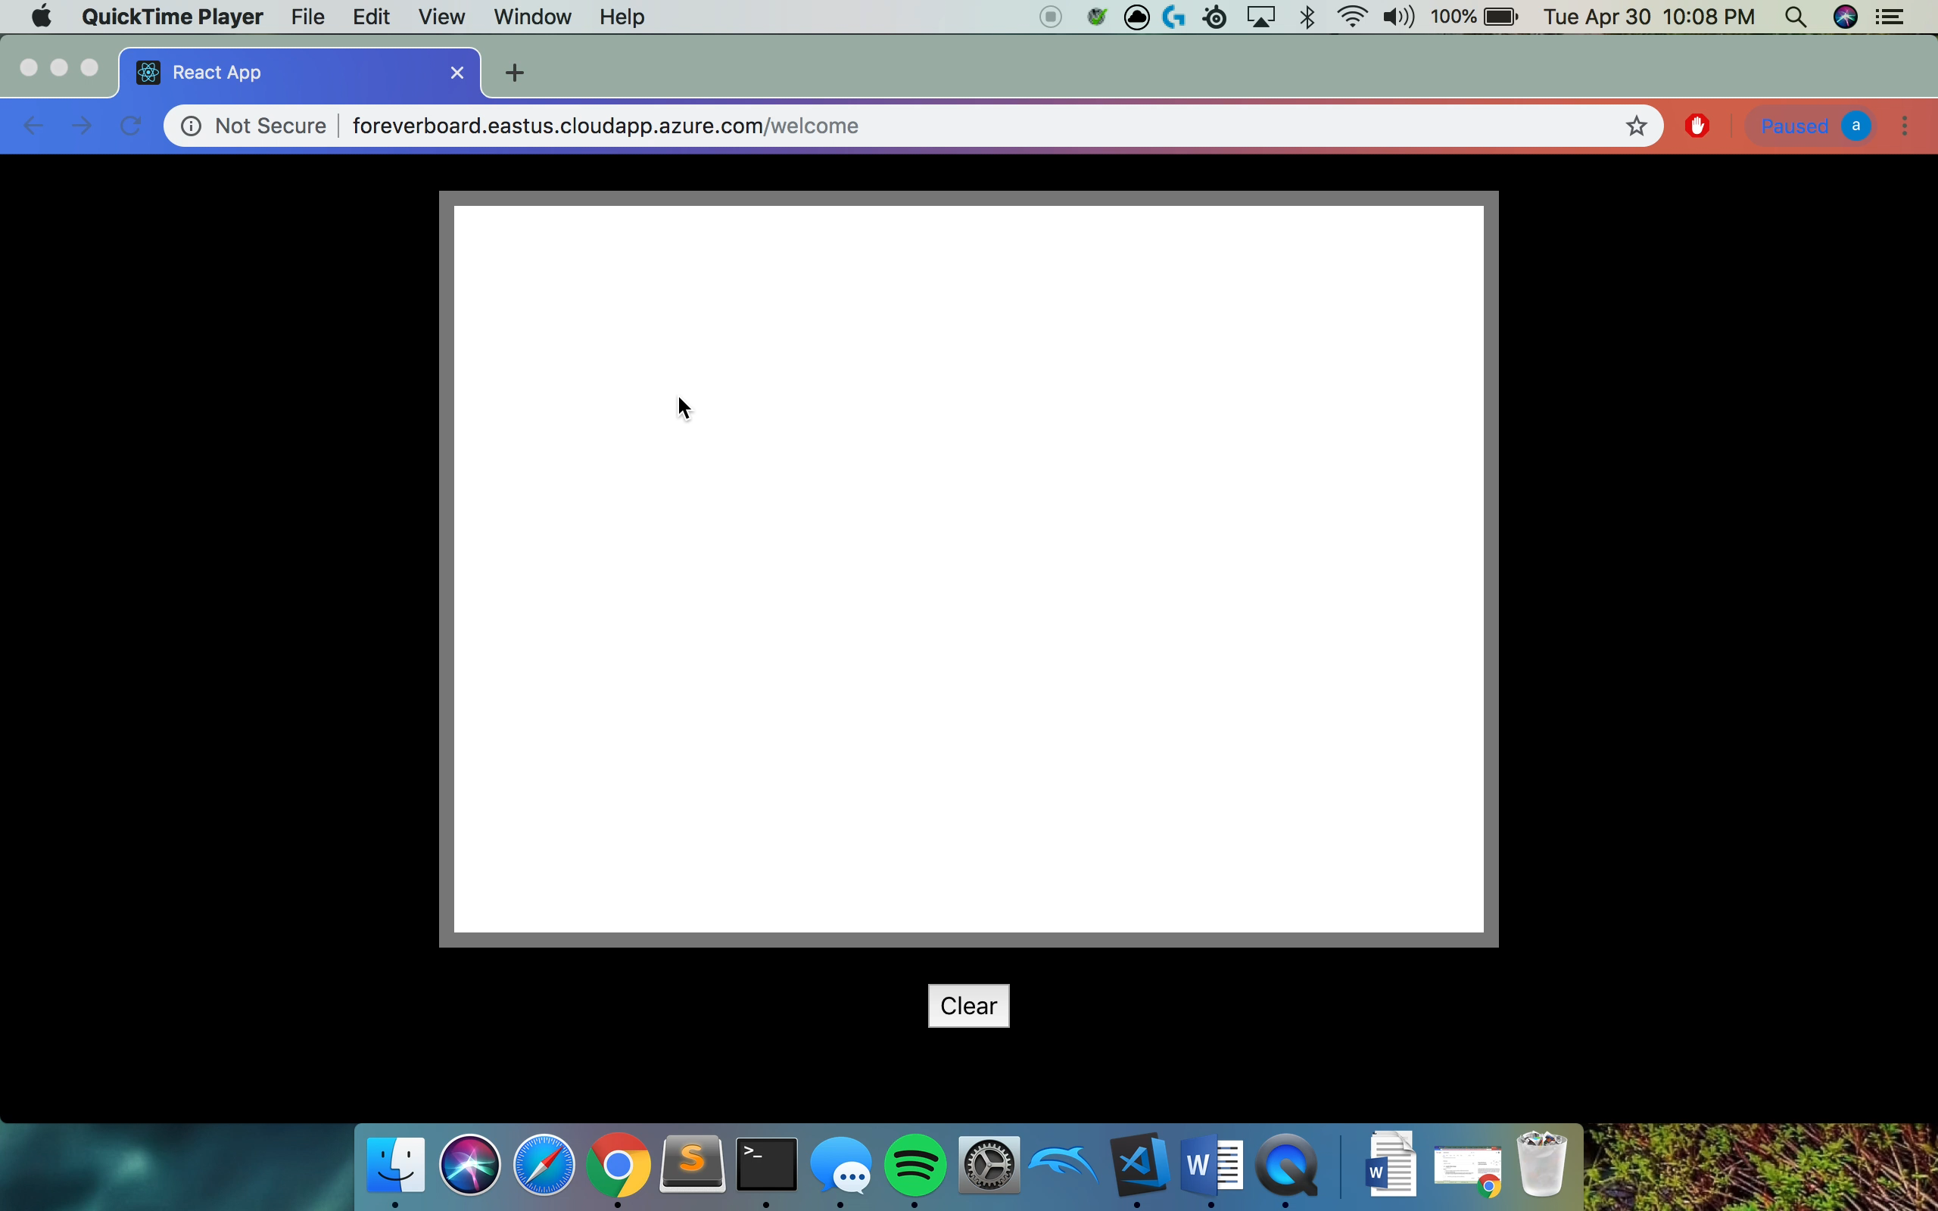
Demo

Slide 5
Technologies Used
React – JavaScript UI library. Used to generate SVGs and create the UI.
Socket.io – JavaScript library to communicate between user and server both directions in real time. Used for live updating of the drawings.
Node.JS – Allows me to run JavaScript on my local computer. I used this for my webservers.
Express – JavaScript library to handle browser requests. This is an alternative to PHP when running on node.
MySQL – Used to store drawings incase the server goes down.

Slide 6
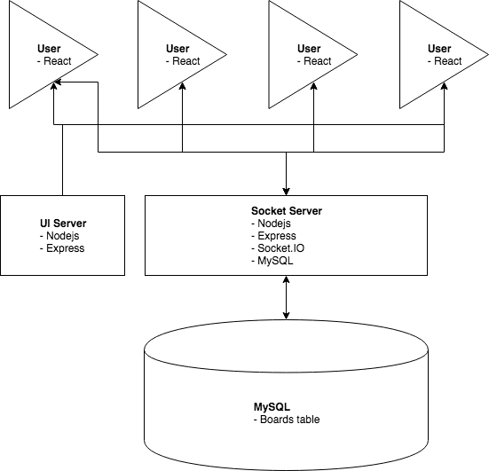
Architecture Diagram

Slide 7
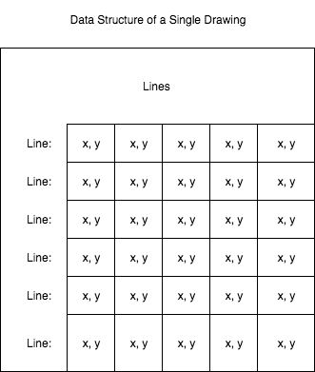
Data Structure of a Drawing On Browser
This is converted into SVG html with the path tag. This path tag has the ‘M’ command on the first point to start the cursor there and the ‘L’ between each x,y to make a line between them.

Slide 8
My Story: Getting The Drawing
Started with the server first, but what is a drawing?
Moved to client first to get the drawing down
Got the drawing working
Now I had to make it live

Slide 9
My Story: Time To Go Live
Started with the live updating by always sending full picture
Had some bugs – Ex: Lost Lines at the Same Times
Moved to pushing just the last line drawn
Now I had to add URL paths

Slide 10
My Story: All URLs Are Equal And Valid
Had to make the clients send their url path to the server
Wanted the server to send new lines to only clients at that path
Couldn’t figure this out so I had clients ignore lines from different URLs
Clients get all the lines from all urls, but only show the right ones
Now I wanted to save the drawings

Slide 11
My Story: The ””Database””
Wanted to create a schema to save the complex drawing structure
Had a temp table in place to keep things working
Ended up settling for a shortcut and using this temp table
Mmooooooving onnnnn…….

Slide 12
My Story: The Internet
Deployment!
Started with a windows virtual machine
Couldn’t figure out IIS server program (404)
Switched to linux
Just ran the node servers on linux and seemed work!
foreverboard.eastus.cloudapp.azure.com

Slide 13
Things Learned
Intro to complicated Async programming
A lot of javascript
Bunch of libraries

Slide 14
Future Improvement
Database
Colors
Eraser – two ways (background color, or split lines)
Users
Private Boards – Classrooms, Companies
Efficiency
Custom Titles

Slide 15
Q & A
Have mercy…

